Slide 2

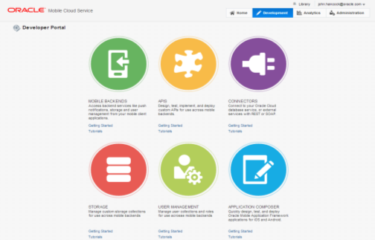
Mobile Cloud & Mobile Service – Solution
Simplify building, integrating and analyzing a portfolio of mobile applications
API Catalog for Mobile Apps Developer
Connectors to backend services & enterprise apps
Storage Services for files/content consumed by Mobile Apps
User and Role Management
Push Notification, Data Sync, and App Lifecycle Management Services
Mobile Analytics
Notes:
API Catalog: through which developers can find APIs they need to access from various backend applications
Connectors: to enable developers to connect from the mobile application to the systems of records
Storage: Persistence for data locally to improve performance for mobile clients
User Management: Map users to roles that are specific to the various applications being accessed from the mobile client
Common Backend Services: Simplify development of mobile applications – notifications, data sync, testing, packaging, deployment to corporate or public app-stores
Browser Tool: for non technical business developers to rapidly build and deliver apps to the business
Analysis: Patterns of usage of mobile applications from various devices

Slide 3



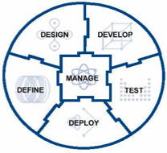



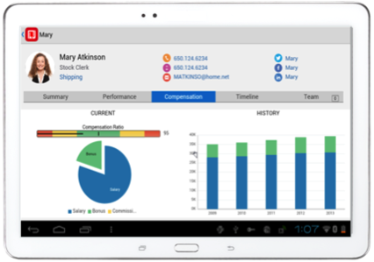
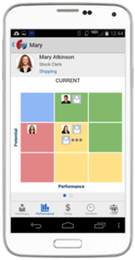



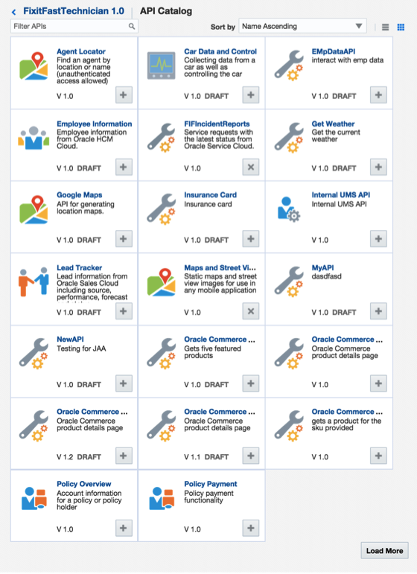


















Oracle Mobile Cloud Architecture
Outside-in, Mobile First
Analytics
Continuous Development
MOBILE APPLICATION FRAMEWORK
Diagnostics
Usage
Engagement
Monitoring
Inside-out, Service first
SDLC
Built-in APIs
Offline Sync
User Mgmt
Native
Mobile
Cloud Service
ICS
OSB / SOA
Cloud
Notifications
Storage
Connectors
Mobile APIs / SDKs
SECURE
Public Cloud
Oracle Cloud
Enterprise SaaS
On-premise
On-Premise Packaged Applications
3rd Party API
Others
Custom API
Users
Data Shaping
Objs
Custom
Logic
Orchestrate
CUSTOM Applications
3
Notes:
The Oracle Mobile Service goal is to easily enable mobile application developers that are continually looking for new ways to accelerate development of apps to meet their consumers’ needs. MCS will be a set of cloud-based, server-side mobile services to make app development quicker and easier to deploy. MCS reduces the complexities of the application development by dealing with the complex server side programming, reducing the redundancy in creating backend code blocks, providing ready to integrate features and template backend.
Developers can focus more on the front end of the applications and can have their choice of mobile client development tools including ADF-Mobile for cross platform hybrid apps, native development or other Javascript tools – creating a new meaning for BYOD – Bring your own development
MCS provides a set of rich RESTFul interfaces for all the operations required by the mobile app that abstracts the backend from the mobile developer. In addition it also provides mobile specific interfaces for notification (multi channel – app, SMS), offline data sync, persistence services (to store mobile generated data and user preferences) as cloud data storage service.
From a backend perspective, MCS provides all the tools required by API developers to expose and shape the services to be consumed by the mobile developer. This includes mechanisms to design, create and expose these services in a catalog that can be easily and securely discoverable by mobile developers and integrated into their app.
Security is a critical component and is designed ground up in the MCS. From tokens to developers to develop and consume APIs to encryption policies for data in rest, data in motion, policies for single sign on and federated authentication across multiple data sources via Oauth or SAML and policies for defining access rights to applications via mobile application management or container technologies are services that will be available in MCS
A key component of MCS is to provide developers, IT and business with metrics on service usage and business impact. MCS will be designed to provide technical metrics, engagement metrics, business metrics along with the monitoring and management of the service.

Slide 4
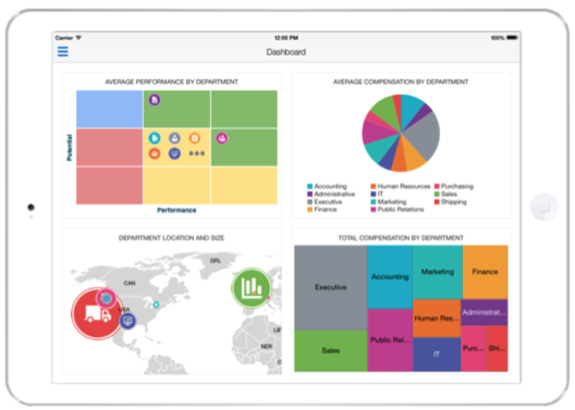
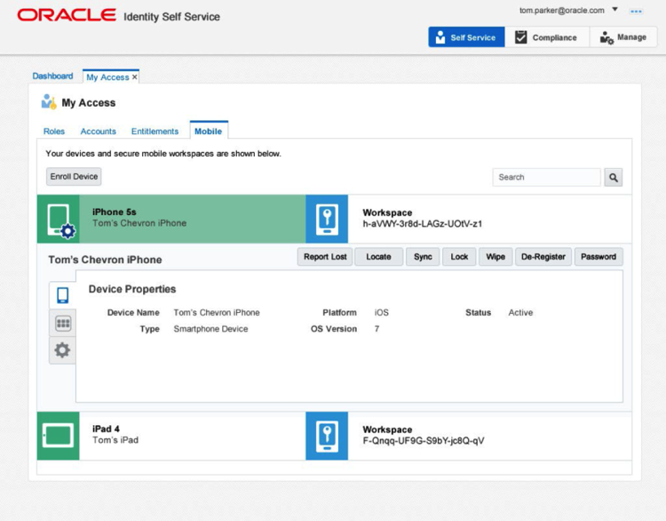
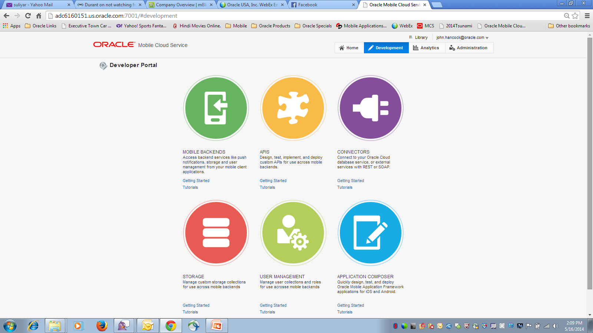

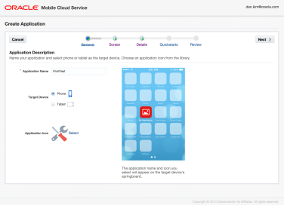
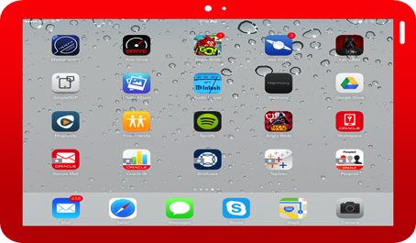
Oracle Cloud SDLC Platform & Tools
Develop, Integrate, Secure, Deploy & Manage
Develop
Integrate, Monitor and Analyze
Secure, Deploy and Manage
Develop
Mobile Application Framework & Accelerator or Native/HTML-JS/.NET
Mobile Cloud Service
Mobile Security
4
Notes:
Oracle’s platform strategy has 3 main components. All of these components are integrated but de-coupled. You can mix and match any of these components. Mobile Cloud Service is our key offering for providing all the enterprise backend services that mobile client developers will need to deliver mobile applications.
MAF provides all the tools for mobile client tool developers to build cross platform mobile applications
Oracle Mobile Security provides the complete enterprise mobile management components including MDM, MAM, MIM, MCM

Slide 5
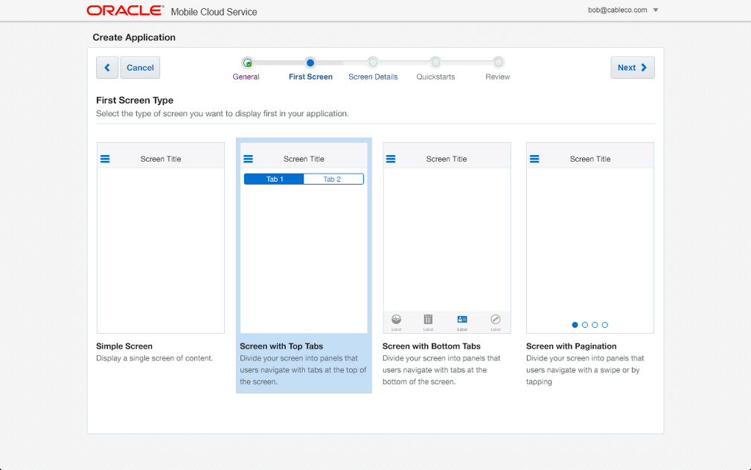
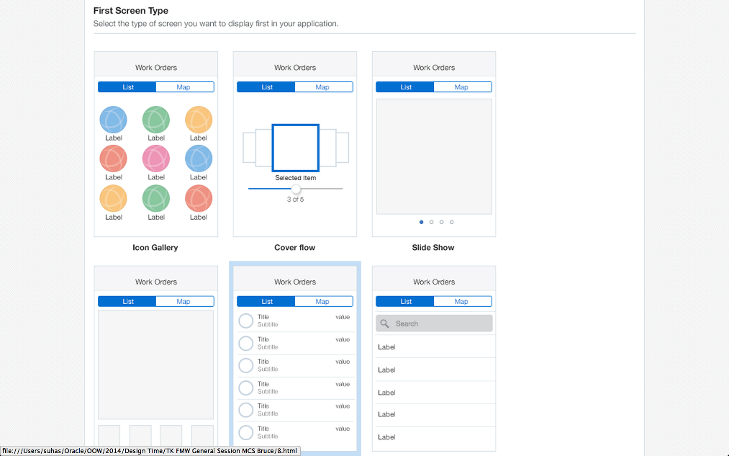
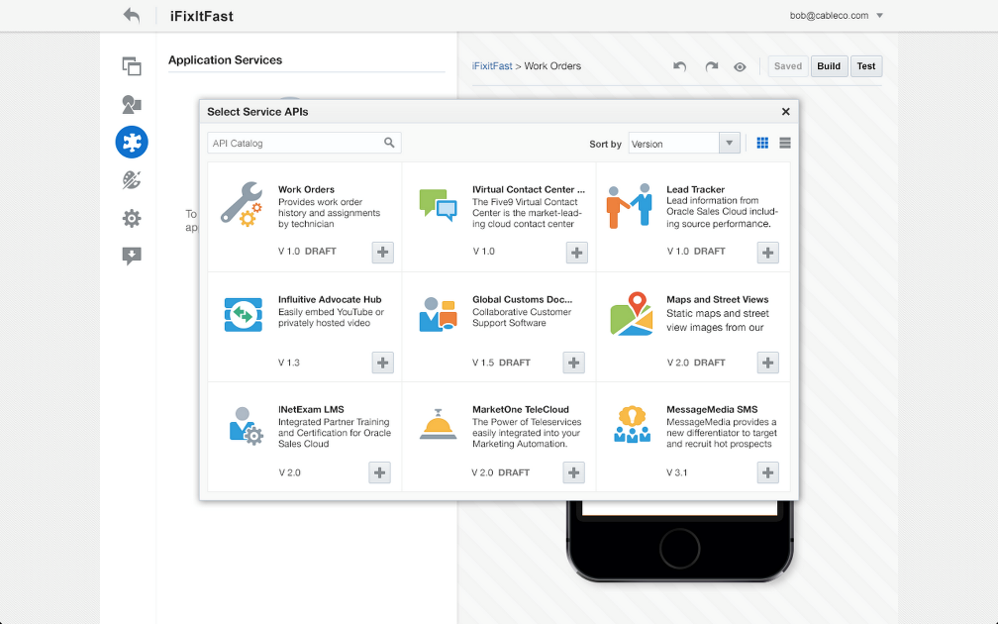
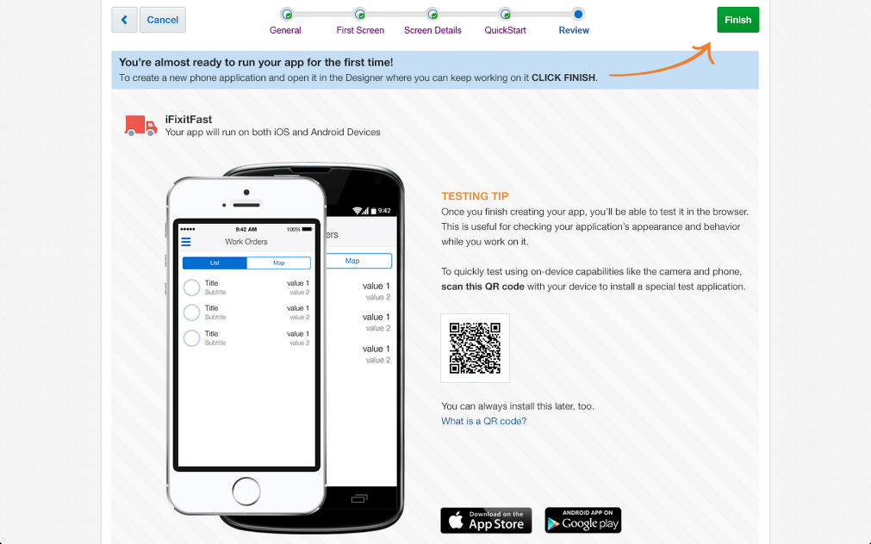
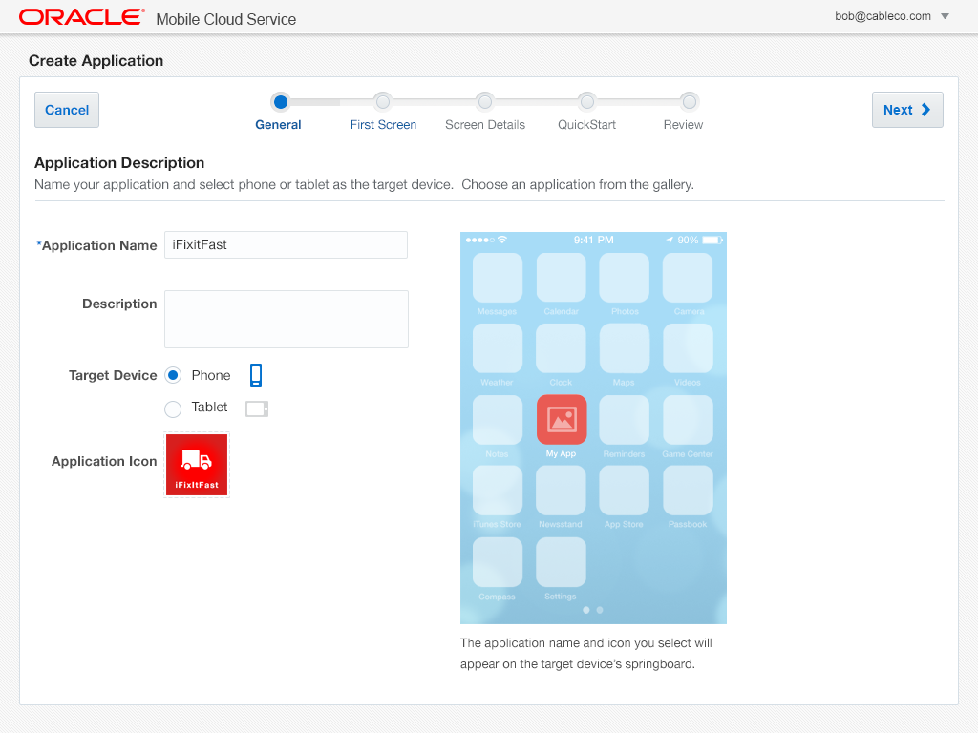
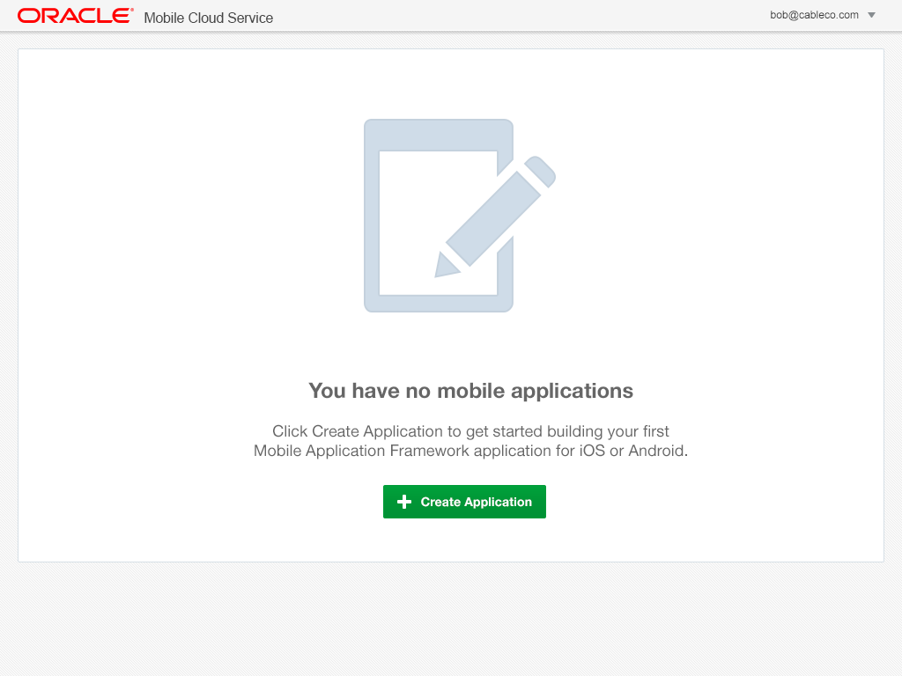
Mobile Application Accelerator (MAX)
Business Analyst - Mobile App Composition in the Cloud
Browser based development
No coding required
Easily map to business services
Preview app in line
Edit, test, and publish from browser
Notes:
The Oracle Mobile Service goal is to easily enable mobile application developers that are continually looking for new ways to accelerate development of apps to meet their consumers’ needs. MCS will be a set of cloud-based, server-side mobile services to make app development quicker and easier to deploy. MCS reduces the complexities of the application development by dealing with the complex server side programming, reducing the redundancy in creating backend code blocks, providing ready to integrate features and template backend.
Developers can focus more on the front end of the applications and can have their choice of mobile client development tools including ADF-Mobile for cross platform hybrid apps, native development or other Javascript tools – creating a new meaning for BYOD – Bring your own development
MCS provides a set of rich RESTFul interfaces for all the operations required by the mobile app that abstracts the backend from the mobile developer. In addition it also provides mobile specific interfaces for notification (multi channel – app, SMS), offline data sync, persistence services (to store mobile generated data and user preferences) as cloud data storage service.
From a backend perspective, MCS provides all the tools required by API developers to expose and shape the services to be consumed by the mobile developer. This includes mechanisms to design, create and expose these services in a catalog that can be easily and securely discoverable by mobile developers and integrated into their app.
Security is a critical component and is designed ground up in the MCS. From tokens to developers to develop and consume APIs to encryption policies for data in rest, data in motion, policies for single sign on and federated authentication across multiple data sources via Oauth or SAML and policies for defining access rights to applications via mobile application management or container technologies are services that will be available in MCS
A key component of MCS is to provide developers, IT and business with metrics on service usage and business impact. MCS will be designed to provide technical metrics, engagement metrics, business metrics along with the monitoring and management of the service.

